Slide 1


Note: The data and information in this document is reflective of a hypothetical situation and client. This document is to be used for KPMG Virtual Internship purposes only.
Sprocket Central Pty Ltd
Data analytics approach
[Division Name] - [Engagement Manager], [Senior Consultant], [Junior Consultant]

Slide 2
Note: The data and information in this document is reflective of a hypothetical situation and client. This document is to be used for KPMG Virtual Internship purposes only.
Data Insights & Presentation.
Introduction : Sprocket Central Pty Ltd is a long-standing KPMG client who has a specialization in high-quality bikes and accessible cycling accessories to riders. Their marketing team is looking to boost business by analyzing their existing customer dataset to determine customer trends and behaviour.
Data Insights: Data Insights is the final step in analyzing the data and deriving the meaningful information through interactive dashboards and visuals. Dashboard is an interactive way to present the desired information which can be easily understood by the viewers.

Slide 3
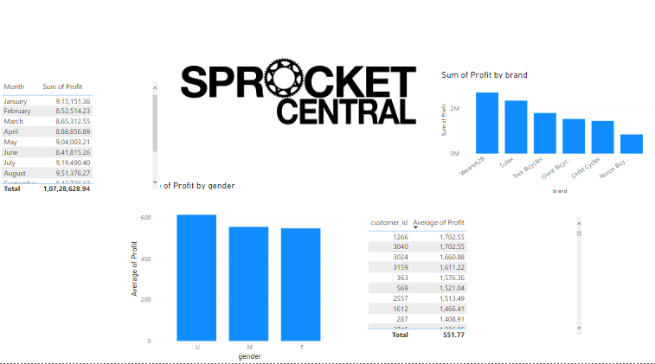
Note: The data and information in this document is reflective of a hypothetical situation and client. This document is to be used for KPMG Virtual Internship purposes only.
Dashboard
Place any supporting images, graphs, data or extra text here.

Slide 4
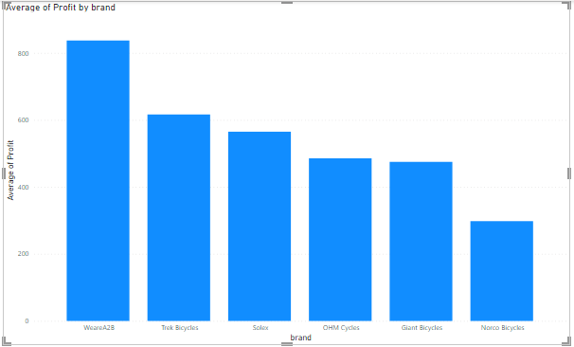
Note: The data and information in this document is reflective of a hypothetical situation and client. This document is to be used for KPMG Virtual Internship purposes only.
KPIs
Trends in Data
The data set helped us to derive some important trends followed through data which are as follows-:
The Undisclosed Gender is contributing towards maximum profit generation for the organization. Herein, Male’s are the bigger contributors when comparing with Female’s.
The WeareA2B is the most popular brand among customers having profit generation of $27,17,685.
Information Systems Manager, Recruiting Manager , General Manager, Social Worker, Internal Auditor are the 5 job titles contributing to the highest profit generators.
The Mass Customers having cars have consumed more cycles than Without Cars.
Most of the revenue generation is from New South Wales.
Place any supporting images, graphs, data or extra text here.

Slide 5
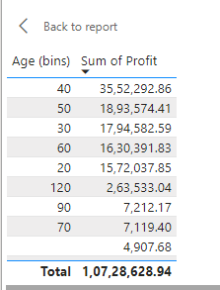
Note: The data and information in this document is reflective of a hypothetical situation and client. This document is to be used for KPMG Virtual Internship purposes only.
KPIs
Trends in Data
The customers lying In the age bracket of 40-50 and 50-60 are the highest contributors in purchasing the cycles.
Place any supporting images, graphs, data or extra text here.

Slide 6
Note: The data and information in this document is reflective of a hypothetical situation and client. This document is to be used for KPMG Virtual Internship purposes only.
Conclusion
Marketing & Growth Strategy
The Data Interpretation suggests that the Marketing Team should focus on Customer who lies in the age bracket of 40-60 with job title as Information Systems Manager, Recruiting Manager , General Manager, Social Worker, Internal Auditor and those who are living in New South Wales.
Also, The Management should focus more on WeareA2B brand which is the biggest contributor in the Profit.
Place any supporting images, graphs, data or extra text here.

Slide 7
Note: The data and information in this document is reflective of a hypothetical situation and client. This document is to be used for KPMG Virtual Internship purposes only.
Thank You

